Slide 1
iNDEX
1-INTRODUCTION
2-FEATURES ANMD CAPABILITIES OF JARVIS
3-BENEFITS OF USING JARVIS AS PERSONAL ASSISTANT
4-EXAMPLES OF JARVIS IN ACTION
5-INTEGRATION AND FUTURE DEVELOPEMENTS
6-CONCLUSION

Slide 2




Introduction to Jarvis (AI) personal assistant
Meet Jarvis, your artificial intelligence (AI) personal assistant designed to make your life easier. From automating mundane tasks to providing real-time information, Jarvis is here to revolutionize the way you interact with technology.
by ADITYA PRATAP SINGH
2200290310011

Slide 3




How does Jarvis work?
Speech Recognition
Jarvis can understand and respond to natural language, making it easy to communicate with the AI assistant.
Data Processing
Jarvis processes information rapidly, enabling quick and accurate responses to user queries and commands.
Machine Learning
Through machine learning, Jarvis constantly improves its performance and understanding of user needs.

Slide 4
Features and capabilities of Jarvis
Personalization
Multi-platform Integration
Task Automation
Jarvis adapts to individual preferences, offering tailored suggestions and recommendations.
Automates repetitive tasks, saving time and streamlining daily routines.
Seamless integration with various devices and applications for a unified user experience.

Slide 5
Benefits of using Jarvis as a personal assistant
1
Increased Productivity
2
Time Efficiency
3
Personalized Assistance
Saves time by managing schedules, reminders, and information retrieval, enhancing overall efficiency.
Jarvis handles routine tasks, allowing users to focus on more strategic and critical activities.
Delivers tailored support and recommendations to meet individual needs and preferences.

Slide 6

Use cases and examples of Jarvis in action
Smart Home Management
Business Assistance
Jarvis can control home devices, adjust settings, and provide real-time updates on home activities.
Helps with data analysis, scheduling, and communication, enhancing productivity in professional environments.
Information Retrieval
Quickly fetches relevant information, news updates, and personalized recommendations for users.

Slide 7
Integration with other devices and platforms
Mobile Devices
Seamless control and synchronization across smartphones and tablets.
Smart Home Systems
Integration with home automation systems for comprehensive device management.
Web Applications
Connects with web-based platforms for information retrieval and task management.

Slide 8
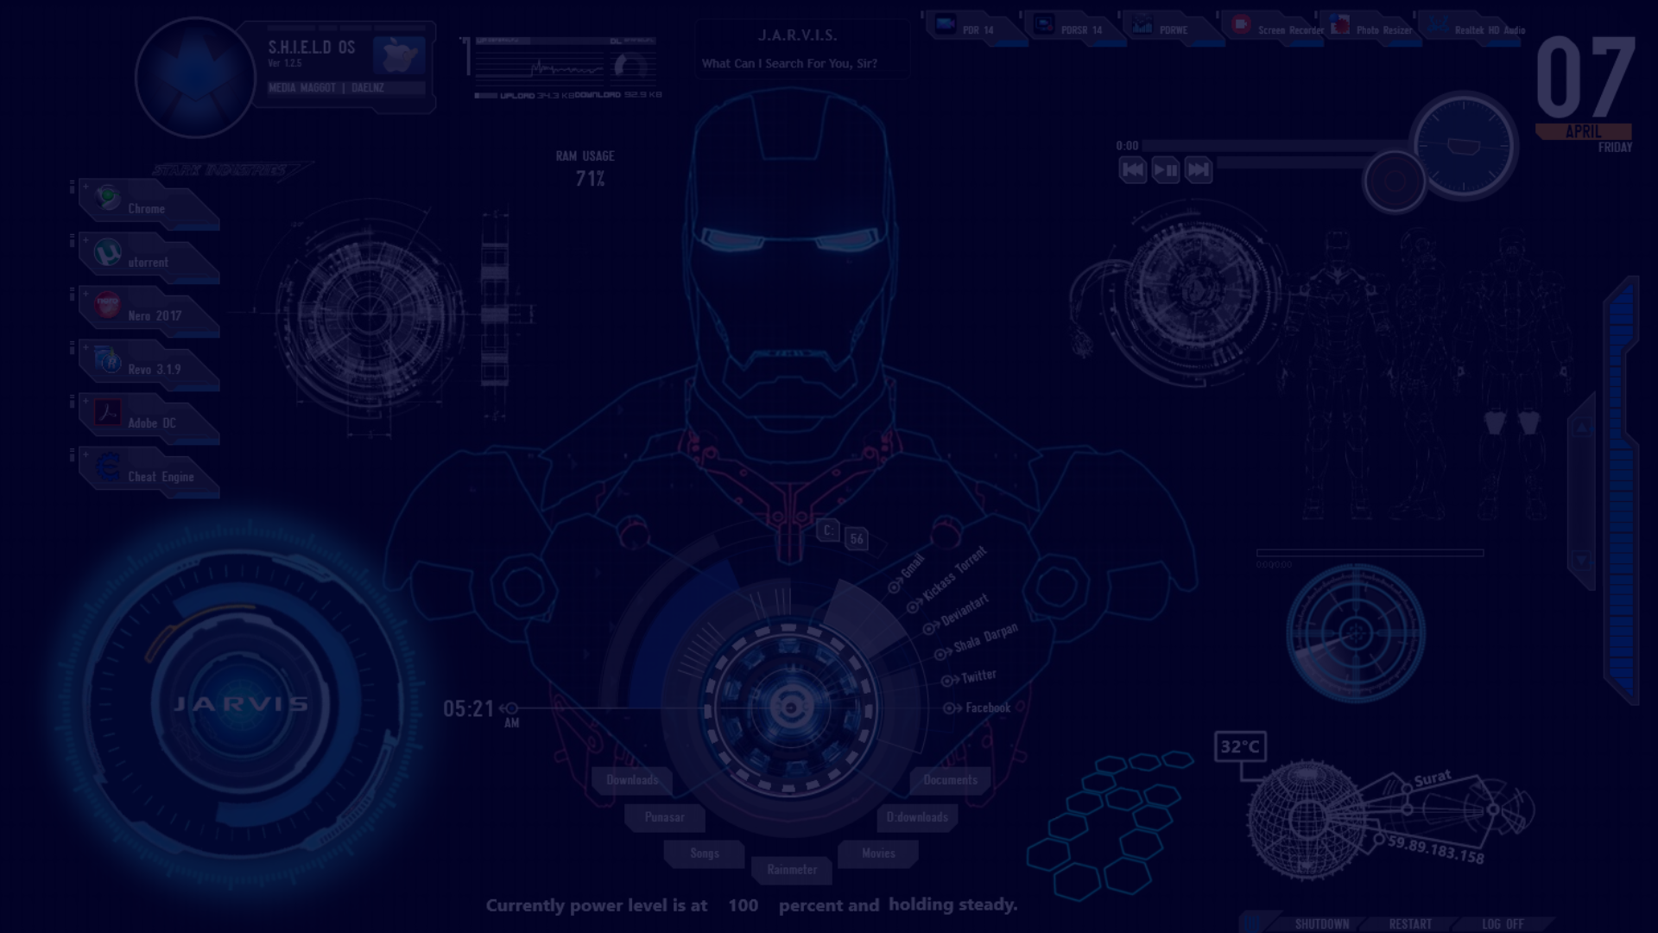
Future developments and enhancements for Jarvis
1
Enhanced Conversational Abilities
Improving natural language processing and contextual understanding for more human-like interactions.
2
Advanced Integration Capabilities
Integrating with emerging technologies and expanding compatibility with new devices and platforms.
3
Enhanced Security Features
Implementing robust security protocols to protect user data and privacy in evolving digital landscapes.

Slide 9
Conclusion and key takeaways
24/7 Support
95%
Accessible Assistance
User Satisfaction
Jarvis provides round-the-clock support for users, addressing queries at any time of the day.
High user satisfaction rates indicate the efficiency and effectiveness of Jarvis in various scenarios.

Slide 10
THANK YOU !!

